Slide 1





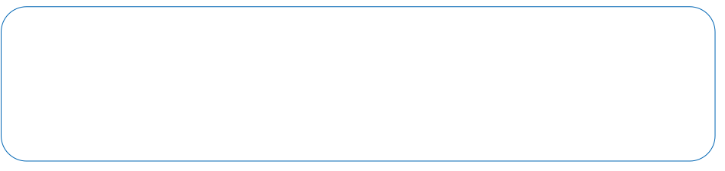
S25' Training Sessions
Mobile App
SESSION 5
#create_share_innovate

Slide 2





Table of contenet
Getting started with Figma
UI/UX Design
UI/UX Importance
S25' Training Sessions
FlutterFlow

Slide 3


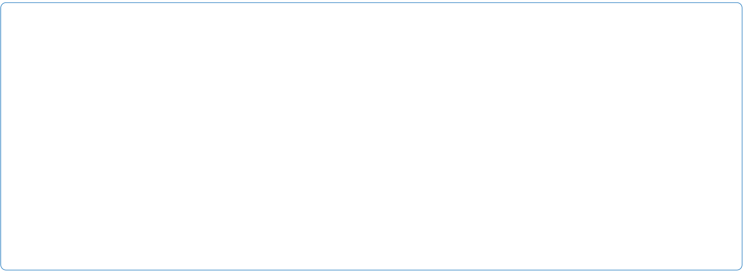
what is ui\ux
UI (User Interface): The visual layout of an app .e.g buttons, colors, typography, spacing, and layout.
UI focuses on how the app looks.
S25' Training Sessions

Slide 4
what is ui\ux
UX (User Experience): The overall experience and interaction a user has with an app.
UX focuses on how the app feels and works.
S25' Training Sessions

Slide 5
UI\UX Importance
Feature | Without UI/UX | With Good UI/UX
User Retention | Low | High
Conversion Rate | Poor | Improved
Development Cost | Higher (due to rework) | Lower
Usability | Confusing | Intuitive
EX:
.Bad UX = 5 clicks to log in.
.Good UX = 1 click with “Remember Me” option.
S25' Training Sessions

Slide 6
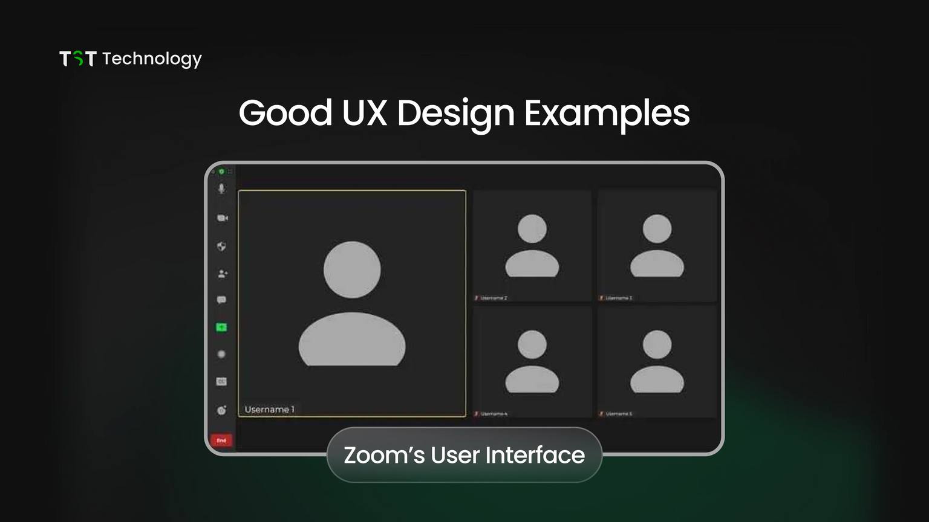
goOd & bad UX
Why is it good?
Zoom has kept its UI simple to make video calls easier. Its layout is clean and uncluttered, showing only the essential
things. Its colour scheme is minimalist
so that users do not have to pay
any attention during video calls.
S25' Training Sessions

Slide 7
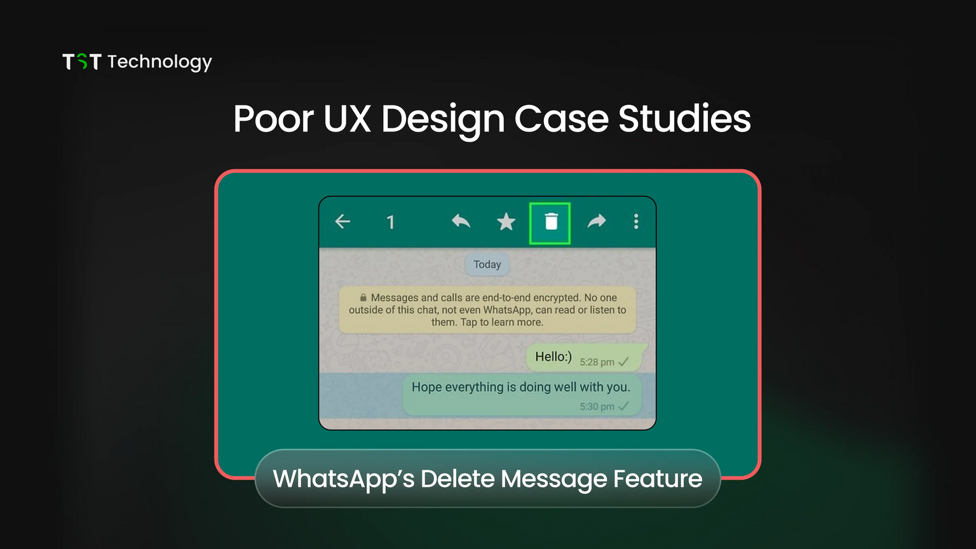
goOd & bad UX
Why is it Bad?
When you accidentally send a message to the wrong person on WhatsApp, you can delete it using the 'Delete for Everyone' option.
But, when you delete the message,
the other person gets a notification
saying "You deleted this message."
S25' Training Sessions

Slide 8
UI\UX Importance
Why does UI/UX matter?
1.First Impressions Matter: Users judge an app within the first few seconds.
2.Better User Satisfaction: A well-designed app is easier and more
enjoyable to use.
3.Higher Retention Rates: A good UX keeps users coming back.
4.Improved Accessibility: UI/UX ensures usability for all, including people
with disabilities.
S25' Training Sessions

Slide 9
figma
What is Figma?
S25' Training Sessions
A web-based design tool for UI/UX design.
Used for prototyping and collaboration.
Getting Started:
Sign up on figma.com(https://www.figma.com/signup).
Create a new Project.

Slide 10
FlutterFlow
What is FlutterFlow?
It’s a low-code visual development platform for building Flutter apps.
Drag-and-drop UI builder for mobile and web apps
Built on Flutter, Google’s UI toolkit
Connects to APIs, Firebase, and more
Exports clean Flutter code
Supports animations, responsive design, and logic flows
Suitable for both designers and developers
Getting Started
S25' Training Sessions

Slide 11
Links
UI Library from Figma Community
UI Kits
S25' Training Sessions
Used Designs
Login Screen
Extra Login Screens
BMI Demo

Slide 12

THANK YOU
SEE YOU NEXT TIME
S25' Training Sessions

